Slide 1
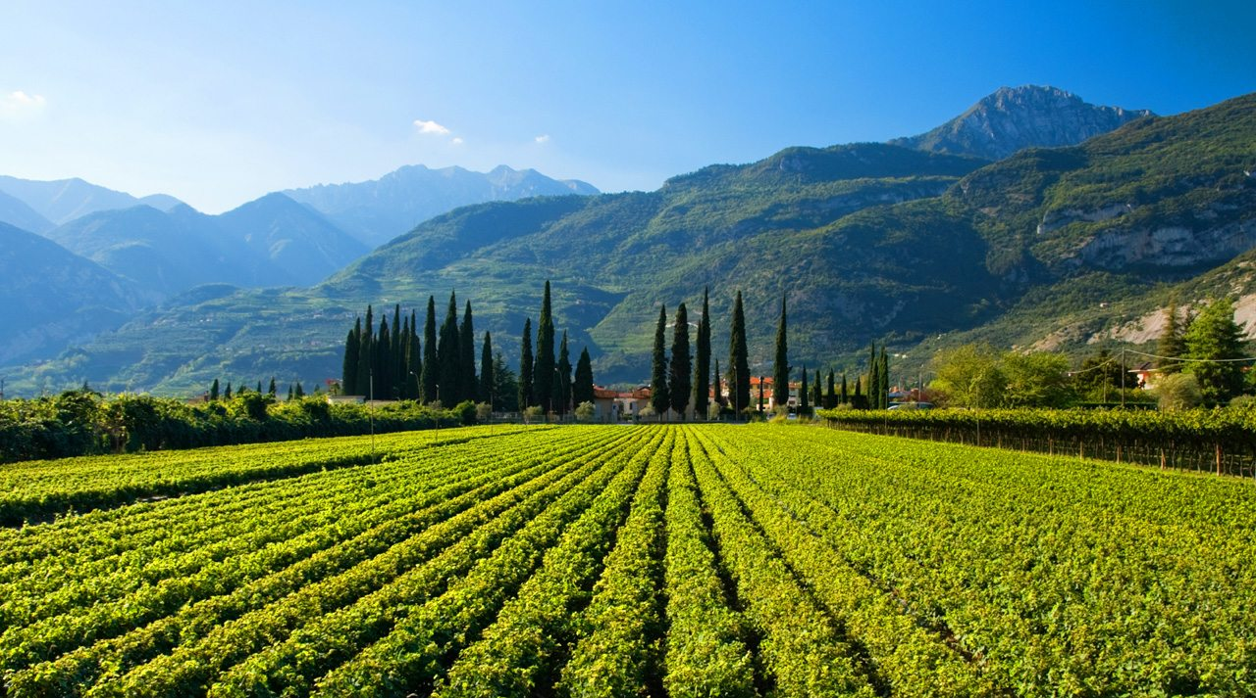
Wine Reviews
Brooke Dickie

Slide 2
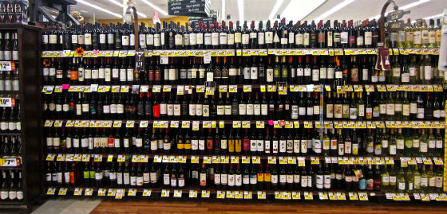
The Problem
Should I buy imported wine? What countries make the best wine for the least amount of money?
What type of wines have the most bang for their buck?
What flavors and aromas can I use to describe wine to make myself sound fancy?
How does the price and the quality of the wine relate? What other attributes of the wine affect that?
Should I just stick to beer???

Slide 3
What’s in my Data Frame?
Price &
Points
Nearly 130,000 reviews scraped from WineEnthusiast
110,000 after removing outliers and de-duplicating
Contains information on wines that rated above 80 (out of 100)
Variety
Location
Description
Taster

Slide 4
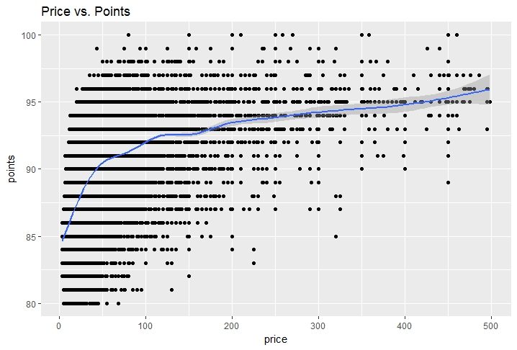
Price vs. Points
Price &
Points
Points range from 80-100
Average was 88.45 points
Prices range from $4 - $3300
Average was $35.56
Removed values above $500
Correlated at an R²-value of 0.25
Variety
Location
Description
Taster

Slide 5
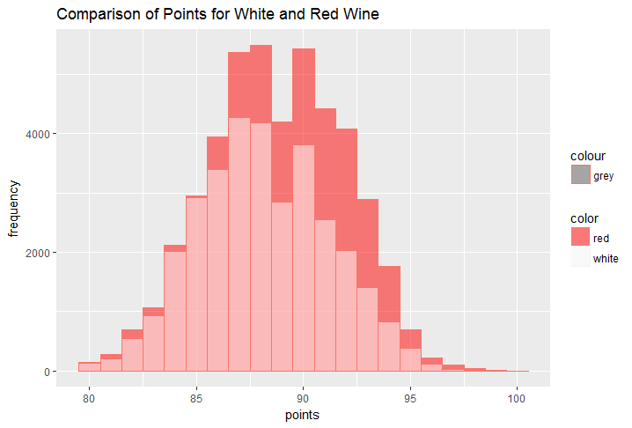
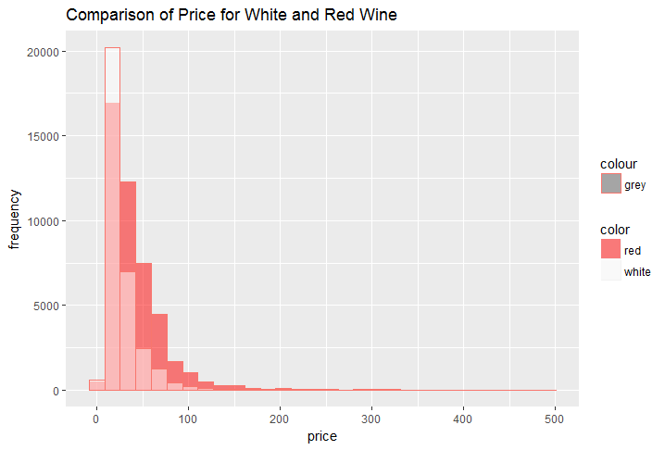
Variety and Color
Price &
Points
Over 700 varieties of wine
Coded as white or red
Overall, red wine was more commonly reviewed
Variety
Location
Description
Taster

Slide 6
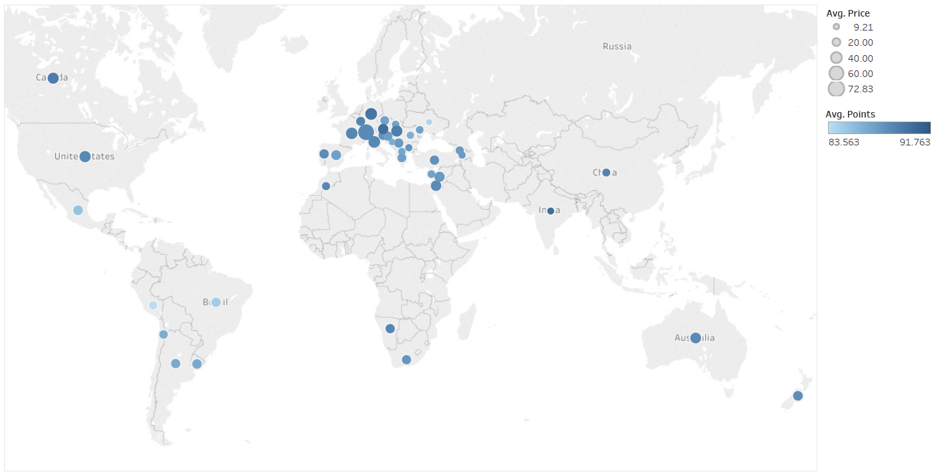
Location - Worldwide
Price &
Points
Variety
Location
Description
Taster

Slide 7
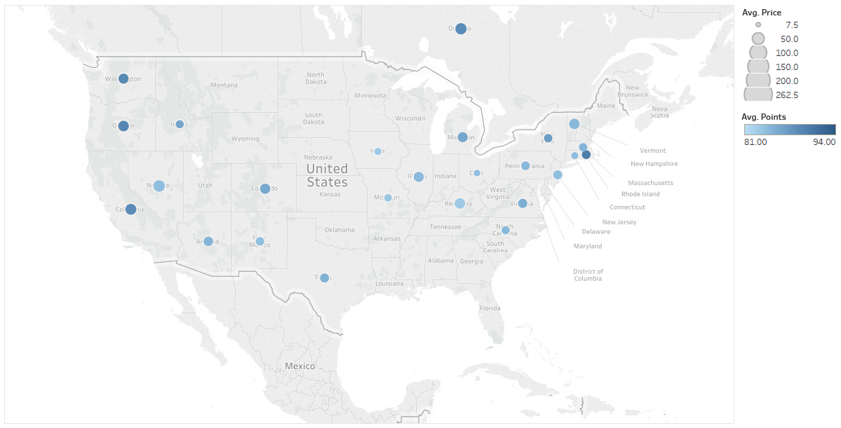
Location - USA
Price &
Points
Variety
Location
Description
Taster

Slide 8
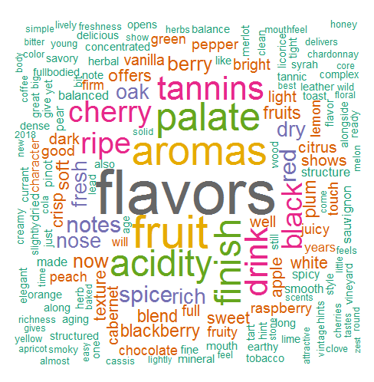
Text Mining on Description
Price &
Points
Variety
Location
Description
Taster
Notes:
Treated each wine label description as its own work in a Corpus

Slide 9
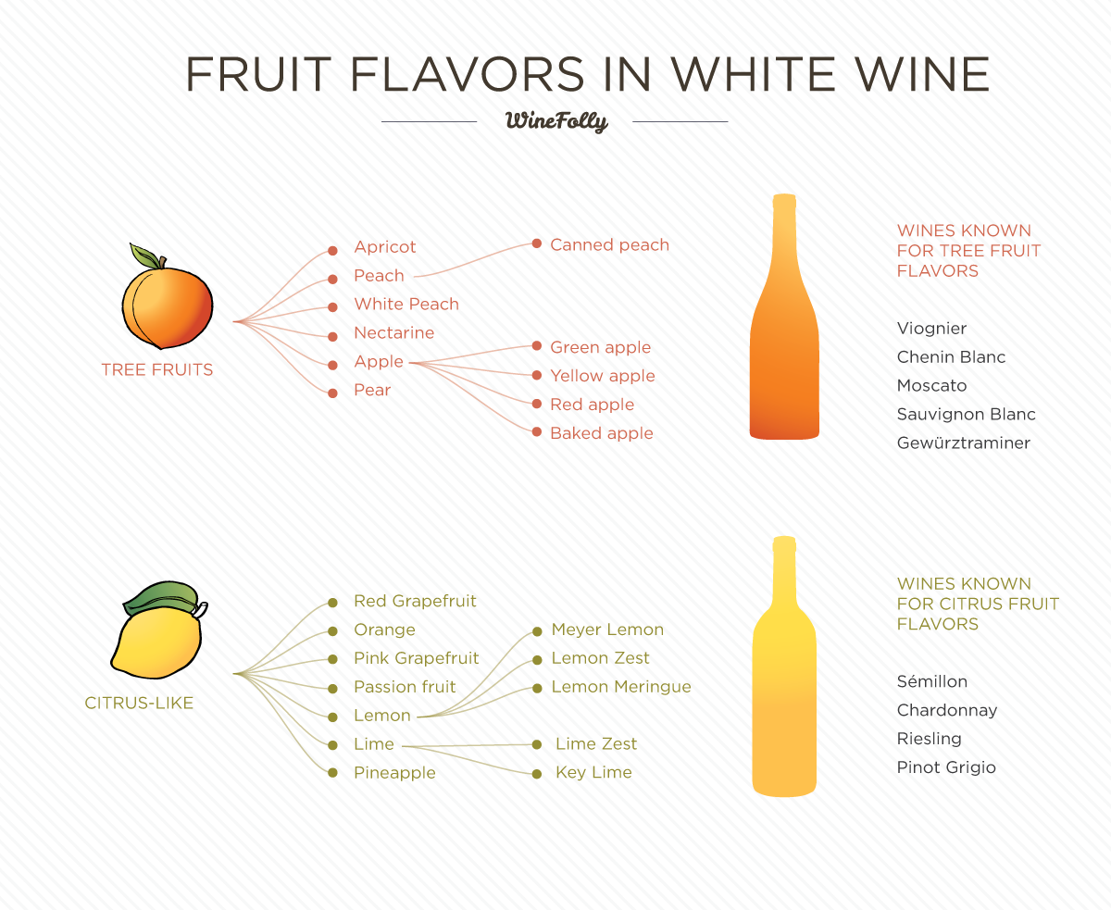
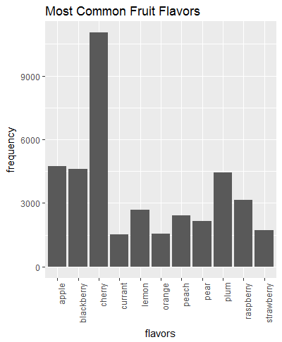
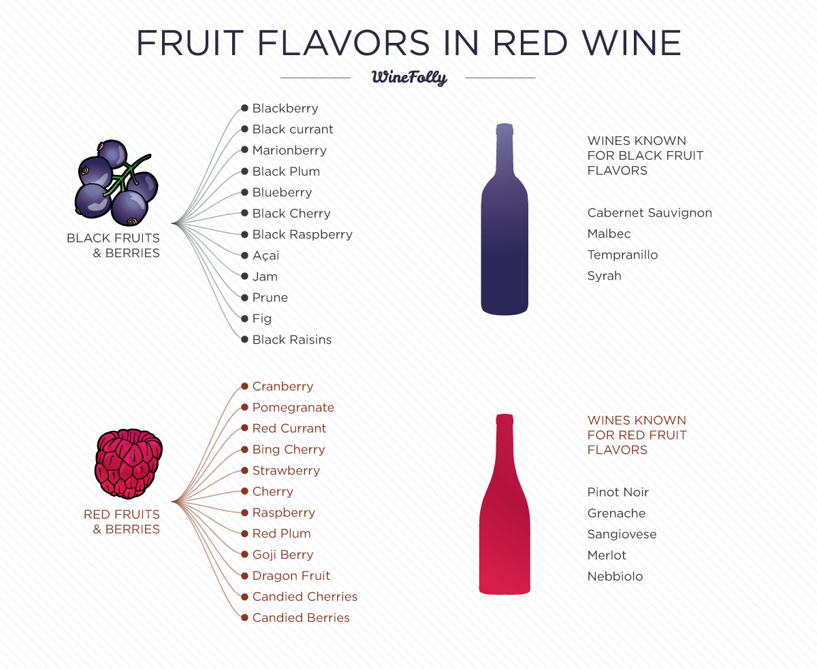
Fruit Flavors
Price &
Points
Variety
Location
Description
Taster
Notes:
Images from WineFolly
List of fruit names from Wikipedia
Examine words used over 1,500 times (over 10% of wines reviewed)

Slide 10
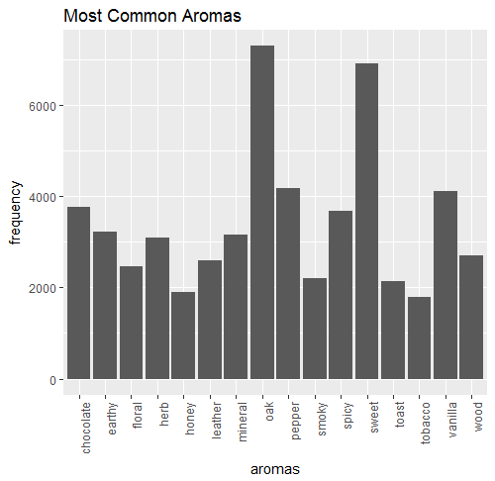
Aromas
Price &
Points
Variety
Location
Description
Taster
Notes:
List of fruit names from Jancis Robinson blog (famous British wine critic)
Examine words used over 1,500 times (over 10% of wines reviewed)

Slide 11
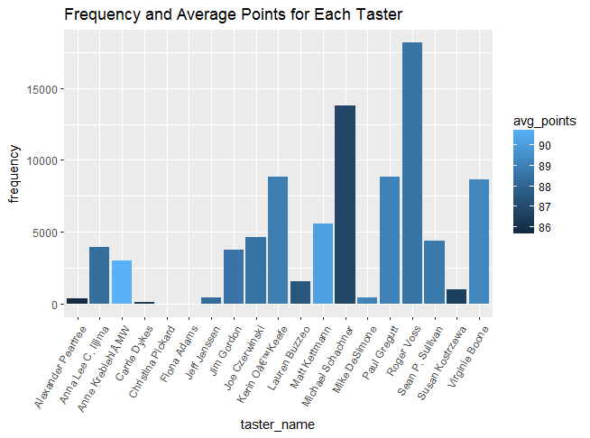
Wine Tasters
Price &
Points
Reporting bias is very real – take results from subjective data with a grain of salt
Variety
Location
Description
Tough critic!
Taster

Slide 12

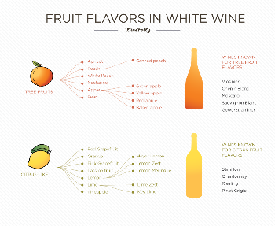
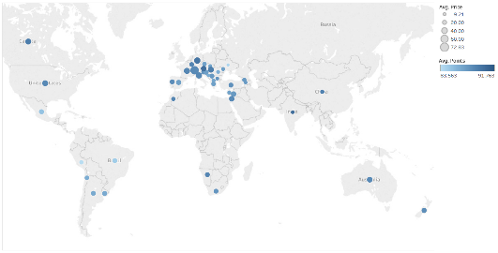
Statistical Analysis
Predicting
Color
Formally quantify trends observed in the graphical analysis
Relationship between price and points for each color of wine
Affect of aroma, flavor, and color of wine on price and points
Varying price and points by location
Aroma &
Flavor
P&P by
Location

Slide 13
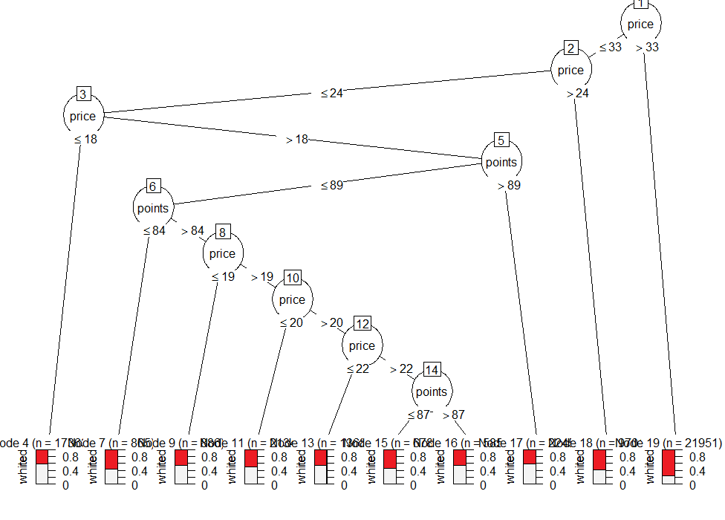
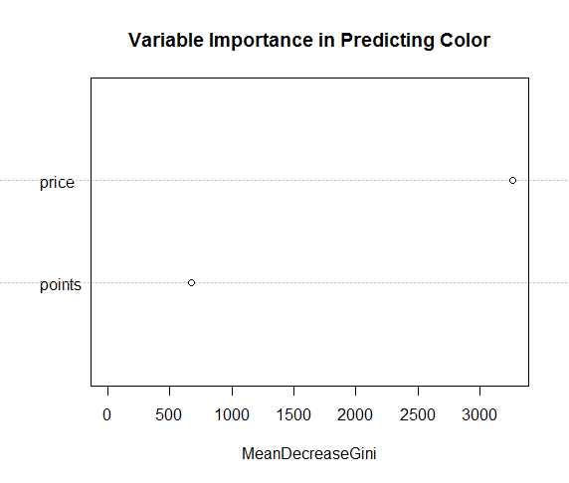
Color Random Forest
Predicting
Color
Color ~ Price + Points
Aroma &
Flavor
P&P by
Location

Slide 14
Color Random Forest Performance
Predicting
Color
Evaluated performance of decision trees with Cross-Validation
k = 8 folds → each fold contained ~10,000 reviews
Accuracy was 62.9%
Aroma &
Flavor
P&P by
Location
 | Predicted
Actual |  | red | white
 | red | 0.416 | 0.166
 | white | 0.205 | 0.213

Slide 15
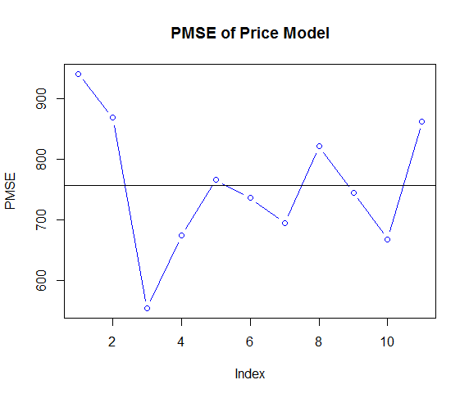
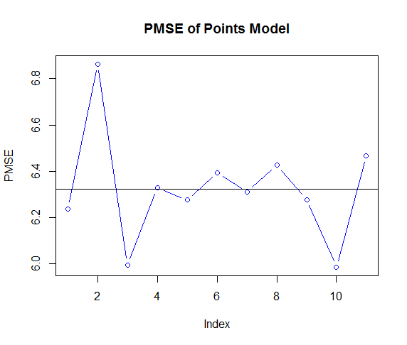
Aroma & Flavors Linear Models
Predicting
Color
Price ~ Flavors + Aromas + Color
Points ~ Flavors + Aromas + Color
Aroma &
Flavor
P&P by
Location
Evaluated performance of both linear models with Cross-Validation
k = 10 folds → each fold contained ~2,500 reviews

Slide 16
Aroma & Flavors Models – Results
Predicting
Color
t-Test to compare if coefficient is significantly different from zero
Base Cases: apple (flavor), almond (aromas), white (color)
Results: at the 0.001 significance level…
Points: 8 flavors, 4 aromas
Price: 11 flavors, 11 aromas
Red vs. White: red is $7 more expensive and scores 0.48 points higher
Aroma &
Flavor
P&P by
Location

Slide 17
Aroma & Flavors Models – Significant Variables
Predicting
Color
Price ~ Flavors + Aromas + Color
Points ~ Flavors + Aromas + Color
Coefficient | Estimate | p-Value
coconut | 11.65 | 4.39e-10
currant | 5.27 | 2.21e-4
grapefruit | -6.00 | 7.22e-5
lemon | -4.05 | 4.05e-5
lime | -6.17 | 1.70e-5
pear | -5.16 | 2.17e-6
prune | 10.95 | 7.68e-8
raisin | 10.45 | 7.29e-7
oak | 5.91 | 8.87e-05
spicy | -5.50 | 7.19e-4
toast | 7.33 | 1.36e-5
tobacco | 6 | 8.84e-4
Aroma &
Flavor
coconut | -0.876 | 3.34e-7
P&P by
Location
grapefruit | 0.762 | 4.13e-8
lemon | 0.551 | 1.16e-9
lime | 0.623 | 2.26e-6
pear | .566 | 1.56e-8
prune | -1.542 | <2e-16
raisin | -1.783 | <2e-16
spicy | 0.570 | 1.37e-4
Notes:
Some flavors and aromas lead to a higher price but lower point value, such as coconut, prune, and raisin
Others had the opposite effect, such as citrus flavors (grapefruit, lemon, lime) and spicy aromas

Slide 18
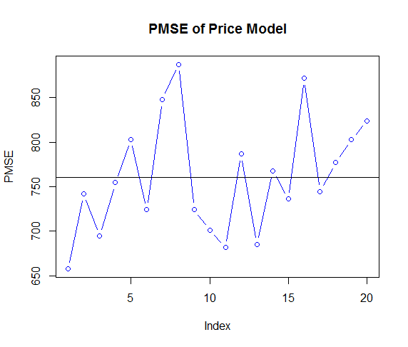
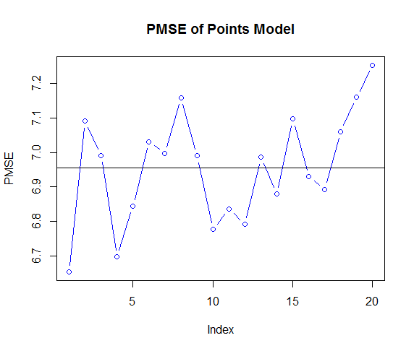
Location Linear Models
Predicting
Color
Price ~ Country
Points ~ Country
Aroma &
Flavor
P&P by
Location
Evaluated performance of both linear models with Cross-Validation
k = 20 folds → each fold contained ~5,000 reviews

Slide 19



Location Linear Models – Results
Predicting
Color
Only considered top 10 producers of wine
t-Test to compare if coefficient is significantly different from zero
Base Case: US
Results: at the 0.001 significance level…
Price: all countries had significantly less expensive wine EXCEPT
Austria’s wine is $14 less, Portugal’s wine is $9 less
Points: Quality of French and Italian wine is not significantly different than the US
Austria’s wine is 1.93 points better, Germany’s wine is 1.10 points better
Argentina, Chile, and Spain all had ~1 point worse
Aroma &
Flavor
P&P by
Location
France
($1.28)
Italy
($2.57)

Slide 20
Conclusions
Don’t just pick up the most expensive wine at the grocery store
White wines are usually the same quality for a lower price
Avoid wines that boast flavors like coconut, prunes, and raisins
These wines tend to be about $10 more expensive and lower quality
Conversely, spicy wines are a great value
Domestic wines are a pretty good value
Wine from France and Italy is a rip-off, buy Austrian wine instead

